Slide 1

Prediction of Electrical Output Power of Combined Cycle Power Plant

Slide 2
Team Members
Ishrat Jahan Ananya | 1631636042
Shamima Haque Priya | 1620069042
Nabiul Hoque Khandakar | 1631164642
Shadman S. Khan | 1611918042

Slide 3
Problem
Predicting output power of a combined cycle power plant from ‘Temperature’, ‘Ambient pressure’, ‘Relative humidity’ & ‘Relative vacuum’ data.

Slide 4
Background theory
Using artificial neural network, it is possible to understand the effects certain factors of environment has on the combined chemical power plant.
Most integrated cycle of power plants work in cyclic conditions. Thus making it hard to determine the facts that has an effect on the electrical power output.
The target was to create a model for this regression problem, which will help us identify the ecological conditions and the natural factors that affect the production of required electrical power.

Slide 5
Dataset Description
Temperature (T) in the range 1.81°C to 37.11°C
2. Ambient Pressure (AP) in the range 992.89 to 1033.30 millibar
3. Relative Humidity (RH) in the range 25.56% to 100.16%
4. Exhaust Vacuum (V) in the range 25.36 to 81.56 cm Hg

Slide 6
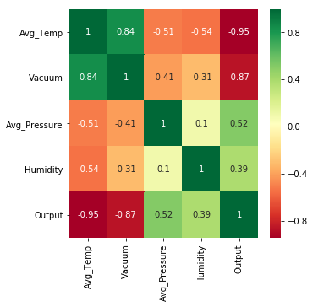
Visualization- Correlation using heatmap

Slide 7
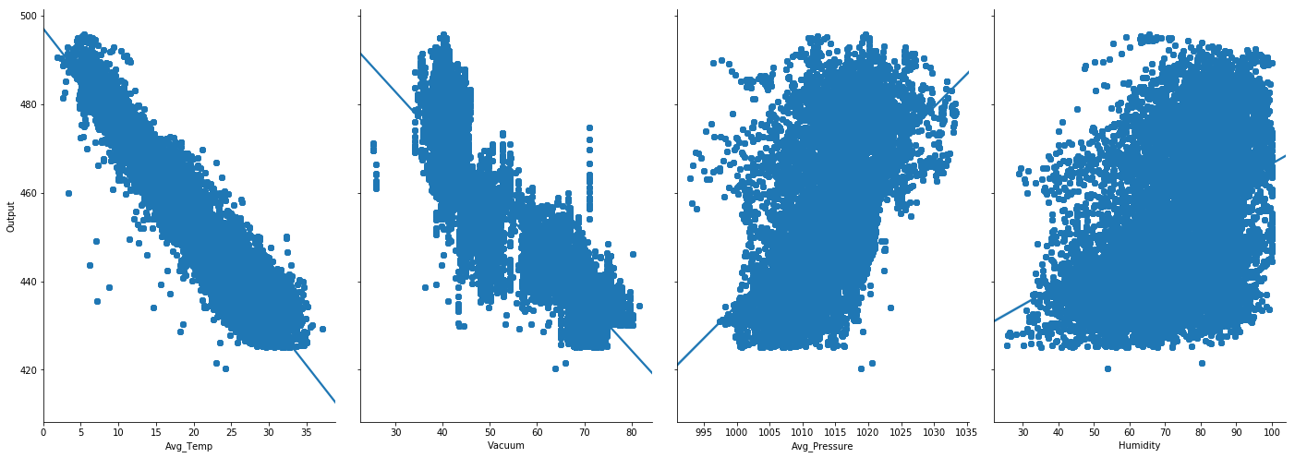
Visualization-Pairplot

Slide 8
Linear Regression
We chose average temperature and fit a linear regression model with a 80-20 % split to see how this attribute affects output. We got the following result:
R2 Score: 0.8991563157354803
Mean Absolute Error: 4.255253824973504
Mean Squared Error: 28.970517905485085
Root Mean Squared Error: 5.382426767312778

Slide 9
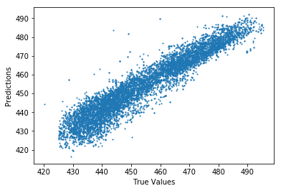
True vs Predicted data
Linear Regression

Slide 10
Multivariable Linear Regression
This time a multivariable linear regression model was fit that included all 4 features and a 80-20 % split to see how this
affects output. We got the following result:
R2 Score: 0.9291122029295451
Mean Absolute Error: 3.6035800582771387
Mean Squared Error: 20.552286757899513
Root Mean Squared Error: 4.533462998404146

Slide 11
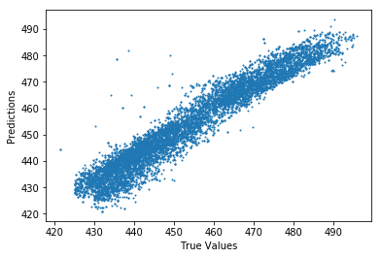
True vs Predicted data
Multivariable Linear Regression

Slide 12
Random Forests
Using RandomForestRegressor() we fit a model onto our dataset and again used a 80-20 split for training and test data. We then got the following results.
R2 Score: 0.9992632731425197
Mean Absolute Error: 0.1626210284281235
Mean Squared Error: 0.21375685911371162
Root Mean Squared Error: 0.4623384681309913

Slide 13
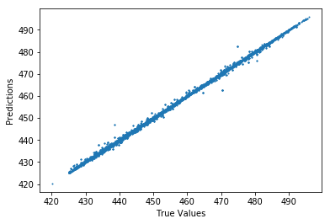
True vs Predicted data
Random Forests

Slide 14
Random Forests
The model fit well but for further understanding we visualized a single decision tree to examine the forest.
The tree is huge containing many layers!
For our purpose we showed only a small portion of 3 layers
Note: The two features that were used to make the decision were ‘Average temperature’ and ‘vacuum’.

Slide 15
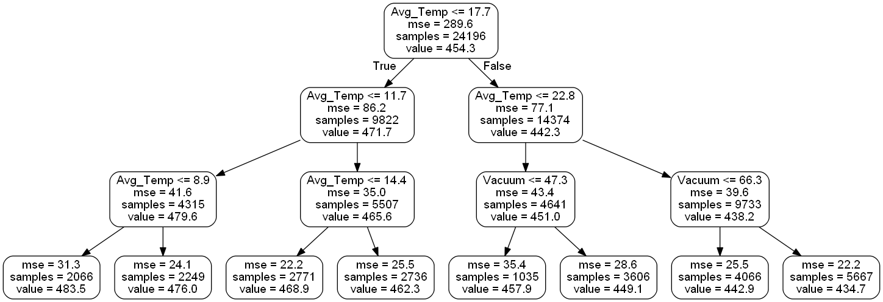
Random Forest - Decision Tree

Slide 16
Random Forests
We then calculated the feature importance to test our hypothesis that ‘temperature’ and ‘vacuum’ indeed has the most affect on output.
Variable: Avg_Temp Importance: 0.89
Variable: Vacuum Importance: 0.08
Variable: Avg_Pressure Importance: 0.02
Variable: Humidity Importance: 0.02
Later a bar graph was plotted to visualize the data.

Slide 17
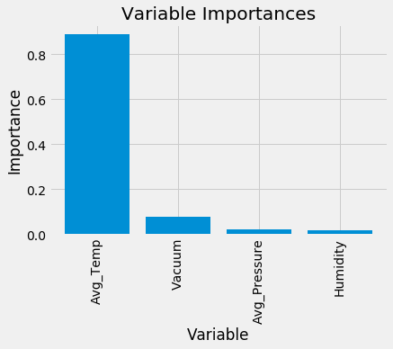
Random Forest –Feature Importance Graph

Slide 18
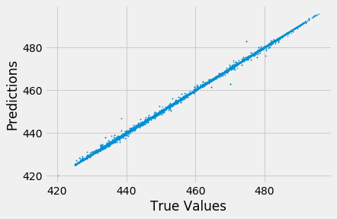
Random Forests
With only the 2 most important feature we fit the random forest model again and got the same result of 99.96% accuracy.

Slide 19
Support Vector Regression
We fit support vector regression model on the data and like the previous models this too had a 80-20 split and then we got the following result:
R2 Score: 0.8657556503192526
Mean Absolute Error: 3.7719542172024596
Mean Squared Error: 39.34637673246207
Root Mean Squared Error: 6.272669027811213

Slide 20
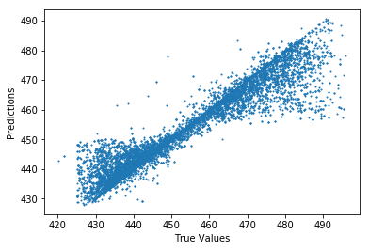
True vs Predicted data
Support Vector Regression

Slide 21
KFold for optimal results with K=5
Cross Validation was applied to compare and estimate how effective our models have been on the Test data.
The following accuracies were achieved:
Cross-Predicted Accuracy for Linear Regression : 0.9286023992684798
Cross-Predicted Accuracy for Random Forest : 0.9581134834394117
Cross-Predicted Accuracy for SVR: 0.4153313655064198

Slide 22
Conclusion
As per our analysis, it can be concluded that for our regression problem the best fit model was the random forest because it gave the best graph and the highest accuracy.
Furthermore, we can say the Electrical Output Power of Combined Cycle Power Plant is can be predicted and is greatly affected by the hourly average ambient Temperature.

Slide 23
Thank You!

